Slide 1
VEHICLE COUNT PREDICTION USING MACHINE LEARNING
181fa04195
181fa04220
181fa04440
Guide: Dr. M.SHANMUGAM

Slide 2
INTRODUCTION
Sensor data is the output of a device that detects and responds to some type of input from the physical environment. The output may be used to provide information or input to another system or to guide a process. An IoT system consists of sensors/devices which “talk” to the cloud through some kind of connectivity. Once the data gets to the cloud, software processes it and then might decide to perform an action, such as sending an alert or automatically adjusting the sensors/devices without the need for the user.
With a sensor, a machine observes the environment and information can be collected. A sensor measures a physical quantity and converts it into a signal. Sensors translate measurements from the real world into data for the digital domain.

Slide 3
OBJECTIVE
The main objective of this project is to apply different Machine Learning Algorithms on IoT Sensor Data to predict the count of vehicles passed at particular junction.
Analyzing the Data
Finding the Hidden trends
Applying the Machine Learning algorithms

Slide 4
ABSTRACT
IoT devices are becoming popular nowadays. The widespread use of IoT yields huge amounts of raw data. This data can be effectively processed by using machine learning to derive many useful insights that can become game changers and affect our lives deeply.
ML is becoming an essential player in a growing array of process areas involving image recognition, natural language processing, forecasting, prediction, and process optimization.
ML is evolving to the point of being able to draw interesting patterns and inferences from these real time data streams, and make those results available to analysts as well as to embed them directly in business processes. We are going to predict traffic apatterns in each of these four junctions for the next 4 months using Ensembling Techniques (Regression Analysis) and other Algorithms.

Slide 5
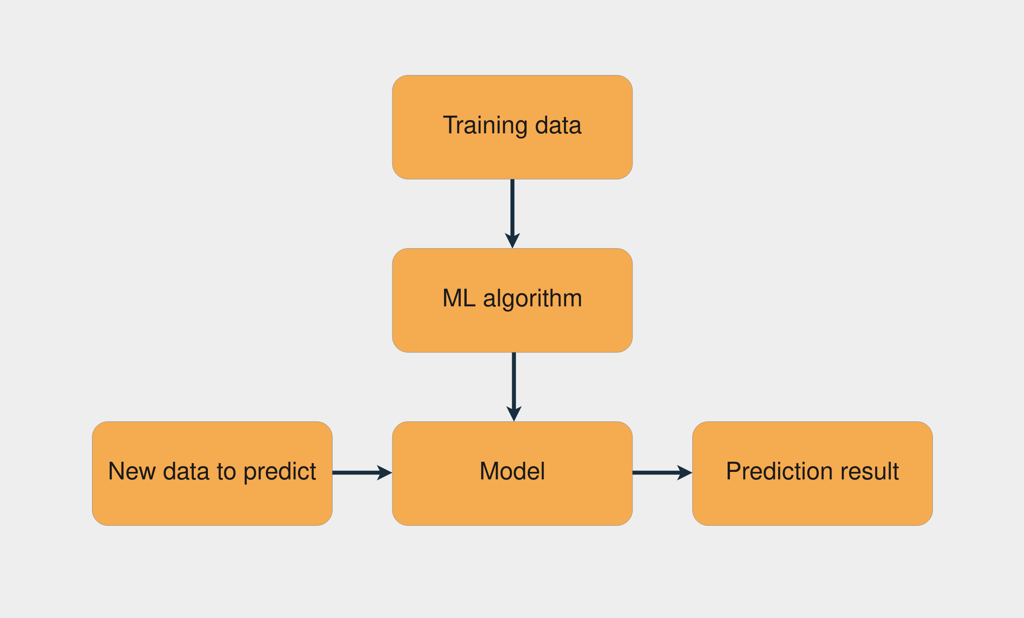
MACHINE learning MODEL

Slide 6
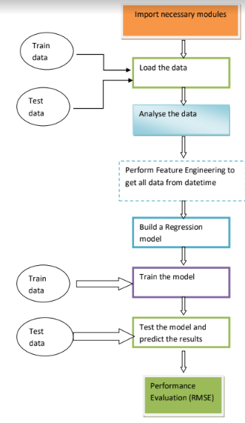
flowchart

Slide 7
REQUIREMENTS
Software Requirements
Windows
Anaconda 3. X (Jupyter Notebook)
Intel i3 processor
Hardware Requirements
Hard disk
Processor: 2.6 GHz.
Ethernet connection (LAN) OR a wireless adapter (Wi-Fi)
Hard Drive: 256 GB
Memory (RAM): 8 GB.

Slide 8
BASE PAPER REVIEW
Tittle : A review of vision based vehicle detection, recognition and tracking.
Author : Al-Smadi, M., Abdulrahim, K., Salam, R.A. (2016)
Proposed methodology : This study established a high-definition vehicle object dataset from the perspective of surveillance cameras and proposed an object detection and tracking method for highway surveillance video scenes. A more effective ROI area was obtained by the extraction of the road surface area of the highway. The YOLOv3 object detection algorithm obtained the end-to-end highway vehicle detection model based on the annotated highway vehicle object dataset.

Slide 9
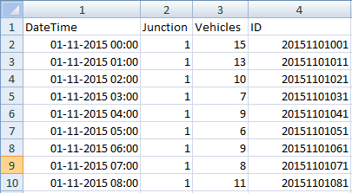
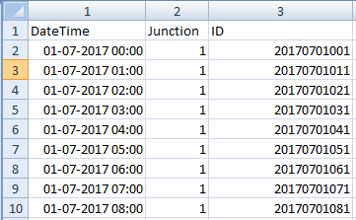
DATA SET DESCRIPTION
Train.csv (48120 X 4)
Variable | Description
ID | Unique ID
DateTime | Hourly Datetime Variable
Junction | Junction Type
Vehicles | Number of Vehicles (Target)
Test.csv (11808 X 3)
Variable | Description
ID | Unique ID
DateTime | Hourly Datetime Variable
Junction | Junction Type

Slide 10
METHDOLOGY
The vehicle count is of numeric type. So we are going to apply Regression Techniques on the data.
Regression:
A regression problem is when the output variable is a real or continuous value, such as “salary” or “weight”. Many different models can be used, the simplest is the linear regression. It tries to fit data with the best hyperplane which goes through the points.
Regression Analysis is a statistical process for estimating the relationships between the dependent variables or criterion variables and one or more independent variables or predictors. Regression analysis explains the changes in criterions in relation to changes in select predictors. The conditional expectation of the criterions based on predictors where the average value of the dependent variables is given when the independent variables are changed. Three major uses for regression analysis are determining the strength of predictors, forecasting an effect, and trend forecasting.

Slide 11
Regression Techniques Applied:
Ensembling Techniques:
Bagging and Boosting are two of the most commonly used techniques in machine learning.
Bagging algorithms:
RandomForest Regressor
Bagging Regressor
Boosting algorithms:
AdaBoost Regressor
Light GBM (LGBM Regressor)
CatBoost Regressor
Gradient Boosting Regressor
Decision Tree

Slide 12
FUTURE STUDY
By the next review we will implement the techniques to the trained data.

Slide 13
REFERENCE
https://www.geeksforgeeks.org/vehicle-count-prediction-from-sensor-data/
https://www.researchgate.net/publication/301481323_Vehicle_detection_counting_and_classification_in_various_conditions

Slide 14


